Slide 1
Memristor Bridge Based Artificial Neural Weighting Circuit
Presented By :
Sumeet Soreng
Tonmay Chakroborty

Slide 2

What is a Memristor Bridge?
Memristor
Register
Memory
Memristor Relates Charge and Magnetic Flux relation
M = dΦ_{m} / dq

Slide 3
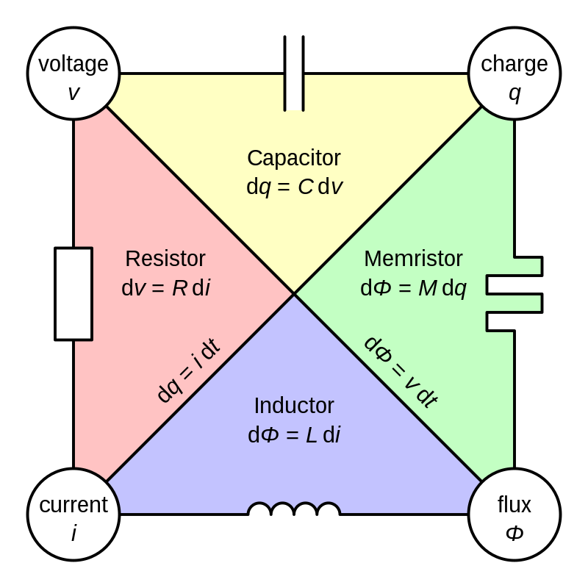
Relation Between Memristor and Other Circuits
Memristance M relates charge Q to flux linkage Φ through M = dΦ/dQ.
Voltage V across a memristor and current I through it are related by V = M(Q) * I.
Relationship between charge Q and flux linkage Φ in a memristor is given by Φ = ∫ M(Q) dQ.

Slide 4
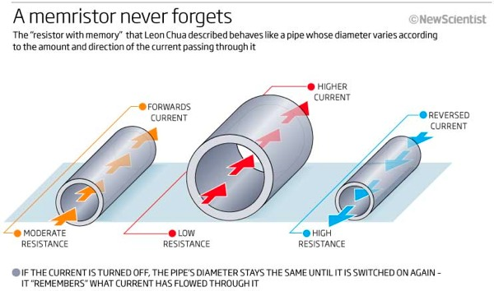

Slide 5

Why Memristor ?
A memristor is an electrical component.
It regulates the flow of electrical current in a circuit.
It has the unique ability to remember the amount of charge that has previously flowed through it.
Memristors are non-volatile, meaning they retain memory even without power.

Slide 6
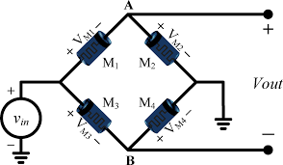
Synaptic Multiplication Using Memristor Bridge
Structure: Resembles a Wheatstone bridge with four identical memristors.
Input Pulses: Positive or negative strong pulses \( Vin) are applied.
Positive Pulse Effect:
Decreases memristance of forward-biased memristors (M1 and M4).
Increases memristance of reverse-biased memristors (M2 and M3).
Result: Positive output voltage \( Vout) (VA > VB).
Negative Pulse Effect:
Opposite memristance changes.
Result: Negative output voltage \( Vout) (VB > VA).

Slide 7
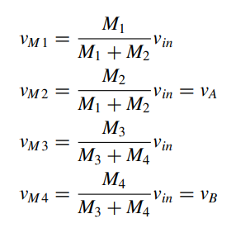

Output voltage of the Memristor Bridge
input signal voltage vin
The input voltage will be divided via the well-known “voltage-divider formula” as follows
The output voltage Vout

Slide 8
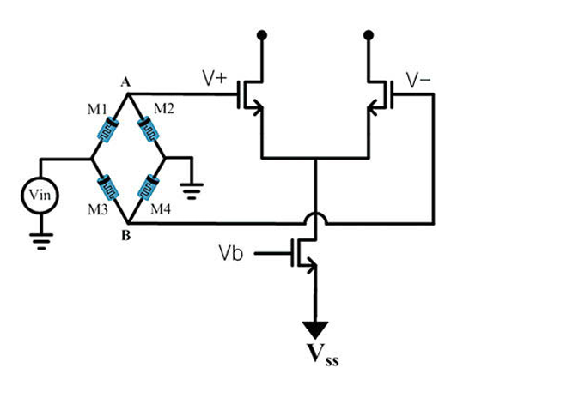
Memristor Bridge Neuron
The memristor bridge neuron sums weighted input signals using current mode circuits. A differential amplifier converts voltage to current, serving as a current source. In the complete circuit, input synapse terminals are connected, and a cell biasing circuit provides DC bias voltage for the output.

Slide 9
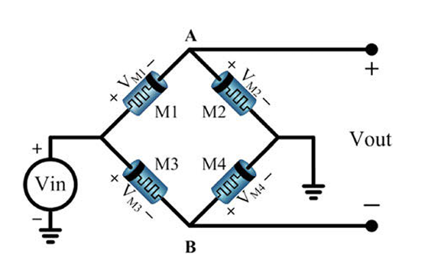
Weight Programming in Memristor Bridge Synapses
Strong pulses are employed in the memristor bridge circuit for synaptic weight programming.
Positive pulses lead to an increase in memristances M2 and M3, while M1 and M4 decrease.
Conversely, negative pulses cause M2 and M3 to decrease, while M1 and M4 increase.
A positive synaptic weight is indicated when the ratio M2/M1 is greater than M4/M3.
Negative synaptic weight is identified when the ratio M2/M1 is less than M4/M3.
A zero synaptic weight is established when the ratio M2/M1 equals M4/M3.
The balanced state denotes zero output, reflecting zero synaptic weight.

Slide 10
Simulation
Computer simulations utilized the TiO2 memristor model for the memristor bridge neuron.
Initial doped-width values were assumed, yielding maximum and minimum memristances.
Linear synaptic weight programming and processing were investigated via simulations.
Feasibility of implementing CNN templates with the memristor bridge was examined.
Synaptic weight processing pulses must be narrow to avoid affecting memristances.
Simulations for weight programming and processing were conducted separately.
Memristance variations were computed after strong programming pulses at intervals.
Branch currents were computed every 4 × 10−4s, followed by memristor charge updates.
Memristors were replaced with resistors for subsequent SPICE simulations after programming.
Synaptic weight processing of the combined resistor-CMOS circuit was performed using SPICE.
Rectangular voltage pulses with fixed amplitude but varying widths were used for weight programming.
For weight processing, fixed-width pulses with varying amplitudes ranging from -1.28V to 1.28V were utilized.

Slide 11
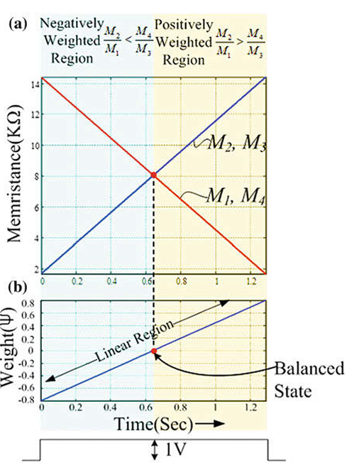
Linearity in Synaptic Weight Programming
Simulations were conducted to showcase the linearity in programming the memristor-bridge circuit, revealing its efficacy in synaptic weight computation. In Fig. a, the memristance changes over time, including M1(t), M2(t), M3(t), and M4(t), were plotted, demonstrating remarkable linearity. Correspondingly, Fig. b illustrates the calculated weights derived from these memristance values, further emphasizing their linear relationship.

Slide 12
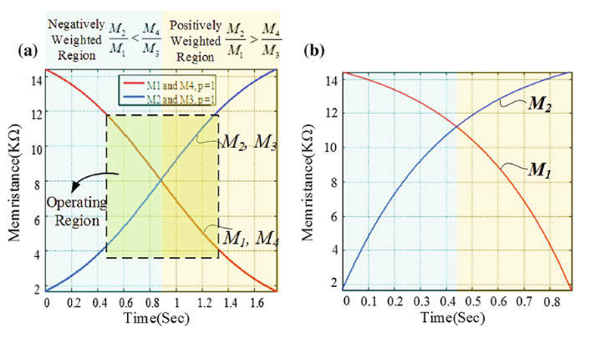
Conversely, applying the same voltage pulse to a non-bridge memristor circuit results in nonlinear memristance changes. Fig. b reveals highly nonlinear memristance changes in a parallel memristor circuit using a nonlinear model, Fig. a shows reduced nonlinearity in memristance changes when employing the memristor bridge circuit with the same nonlinear model.
Linearity in Synaptic Weight Programming

Slide 13
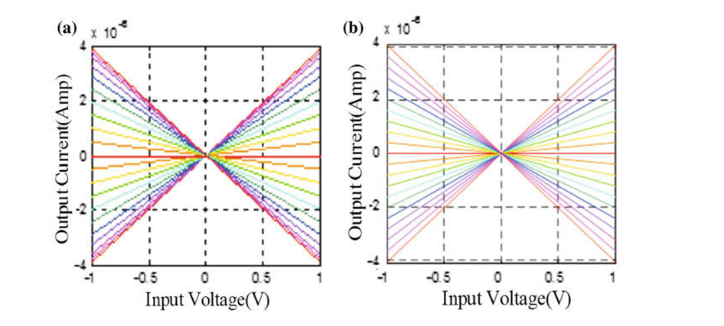
Simulations included synaptic weight processing in the memristor-bridge neuron with nine synaptic inputs, where various input signals were applied to a single synapse. Fig. b displays the superior linearity of our memristor-based synaptic weighting compared to a conventional multiplication circuit (Fig. a). The memristor bridge's linearity stems from linear voltage assignment at the memristors and operation at the center of their dynamic range..
Synaptic Weight (Multiplication) Processing

Slide 14
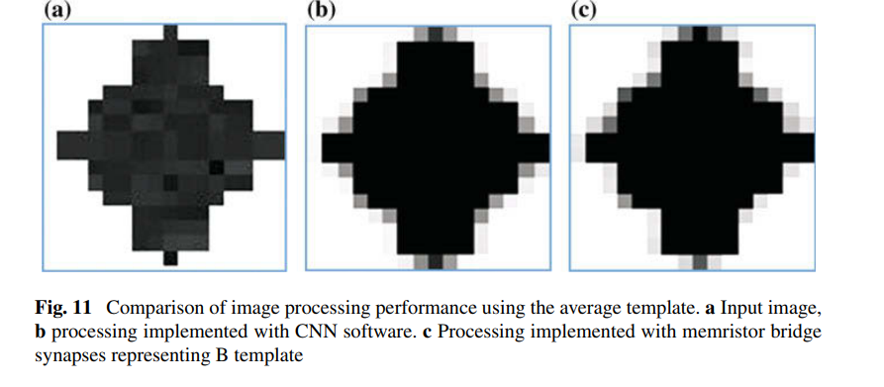
Applications of Memristors
Utilized memristor bridge neurons for 2-D image processing.
Implemented feedforward CNN using memristor bridge synapses.
Circuit had nine synaptic inputs (B template) and one bias voltage (threshold).
Tested average and Laplacian templates with memristor bridge neurons.
Simulated CNN cells using SPICE with a 16x16 input image for the average template.
Compared results between CNN software (Figs. 11b) and memristor bridge synapses (Fig. 11c).

Slide 15
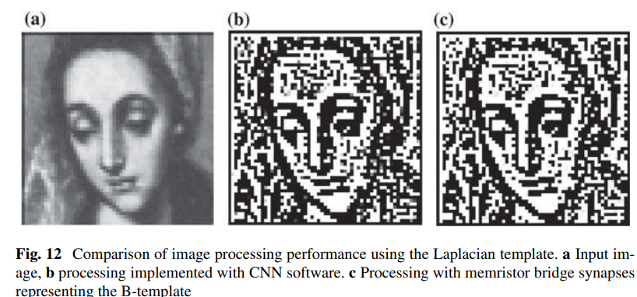
Compared results between CNN software (Figs. 12b) and memristor bridge synapses (Fig. 12c).
Memristor bridge synapse performance close to CNN software with 0.89% and 0.86% average pixel difference for Figs. 11 and 12.

Slide 16

Memristor-Based neuron a VS A Conventional CNN cell
Benefits of memristor bridge synapse circuit: smaller size due to nanometer-scale memristors.
Requires fewer transistors than conventional CNN cells (Table 1).
Circuit operation is pulse-based, resulting in lower power consumption.

Slide 17
Conclusion
Proposed a memristor bridge synaptic circuit for analog weighting and signal processing, surpassing conventional methods in size and power efficiency.
Circuit simulations using TiO2 memristor models demonstrated excellent linearity across positive and negative weight ranges.
Introduced a neuron based on memristor bridge synapses combined with an active load circuit, summing outputs in current mode.
Investigated memristor bridge synapse performance using average and Laplacian CNN templates, achieving processing results closely matching ideal software results through SPICE simulations.

Slide 18
References
https://link.springer.com/chapter/10.1007/978-3-319-02630-5_12
The Scientific American Book of the Brain. Scientific American, New York (1999)
Chua, L.O., Yang, L.: Cellular neural networks: theory. IEEE Trans. Cir. Syst. 35(10), 1257– 1272 (1988)
Chua, L.O., Yang, L.: Cellular neural networks: applications. IEEE Trans. Circ. Syst. 35(10), 1273–1290 (1988)\
Roska, T., Chua, L.O.: The CNN universal machine: an analogic array computer. IEEE Trans. Circ. Syst.-II 40(3), 163–172 (1993)
Kim, H., Son, H., Roska, T., Chua, L.O.: Optimal path finding with space- and time-variant metric weights with Multi-layer CNN. Int. J. Circ. Theory Appl. 30, 247–270 (2002)

Slide 19


